Slide 1
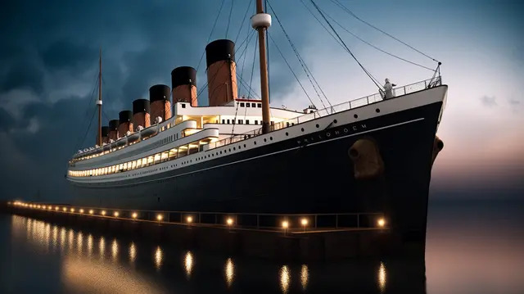


EXLORATORY DATA ANALYSIS AND
MACHINE LEARNING ON TITANIC DISASTER DATASET
PRESENTED BY
V.Sruthi Sangeetha : 21QP1A05C7
S.Varalaxmi : 21QP1A05A7
Y.Kavya : 21QP1A05C8

Slide 2
CONTENTS:
INTRODUCTION
EXISTING SYSTEM AND DRAWBACKS
PROPOSED SYSTEMS
LITERATURE SURVEY
ARCHITECTURE
SCREENSHOTS
GRAPHS
SYSTEM REQUIREMENTS
ALGORITHMS
USE CASE DIAGRAM
CONCLUSION

Slide 3
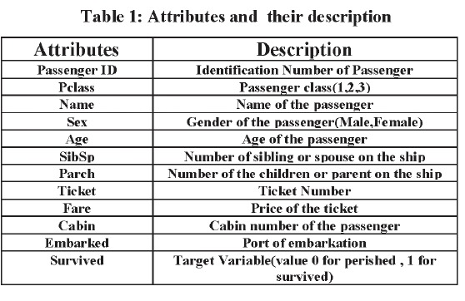
INTRODUCTION
Titanic disaster is one of the famous shipwrecks in the world history.
Titanic is British cruise liner that sank in the North Atlantic Ocean a few hours after colliding with an iceberg.
Over the years, data of survived as well as deceased passengers has been collected.
Dataset is publically available on a website called as Kaggle.com.

Slide 4
EXISTING SYSTEM
The approach existing methods are centered on R and java for executing algorithms- Nave Bayes, Linear Regression.
Various languages and tools are used to implement different algorithms including WEKA, R, and Java etc.
DRAWBACKS
According to Eric Lam and Tang used the Titanic problem to compare the algorithm accuracy which they took the feature of gender.
Poor prediction.

Slide 5
PROPOSED SYSTEM
The predictive model’s purpose is to allow the programmer to predict a value that may be unknown or predict something that might happen in the future.
ADVANTAGES
Reasons behind people who survived and who they are?
The economic class have to do with the chances of survival
The gender of the person influence the chances of survival
Age of someone a crucial parameter in determining the survival.

Slide 6
LITERATURE SURVEY
Predicting The Survivors Of The Titanic Kaggle, Machine Learning From Disaster
AUTHORS: Farag, Nadine, and Ghada Hassan
Analyzing Titanic Disaster Using Machine Learning Algorithms
AUTHORS : Singh, Aakriti, Shipra Saraswat, and Neetu Faujdar
An Implementation Of Id3-Decision Tree Learning Algorithm
AUTHORS : Peng, Wei, Juhua Chen, and Haiping Zhou

Slide 7
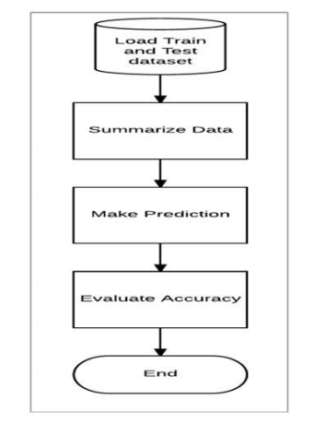
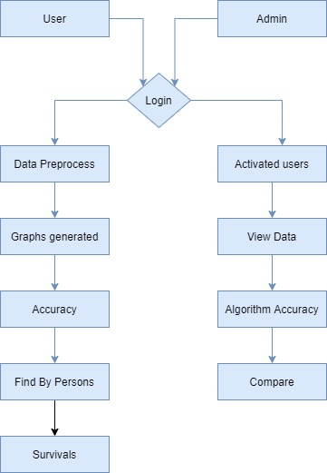
SYSTEM ARCHITECTURE

Slide 8


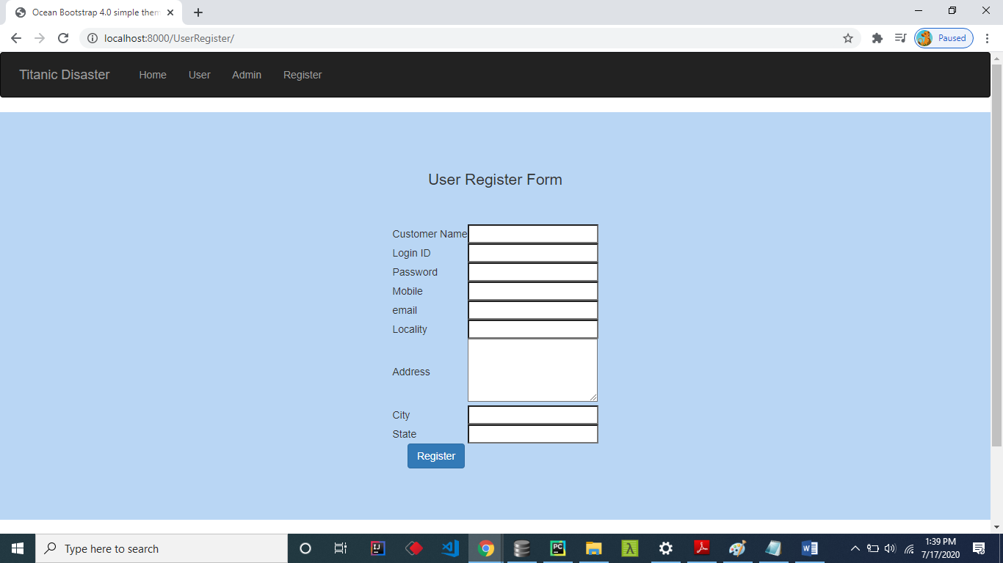
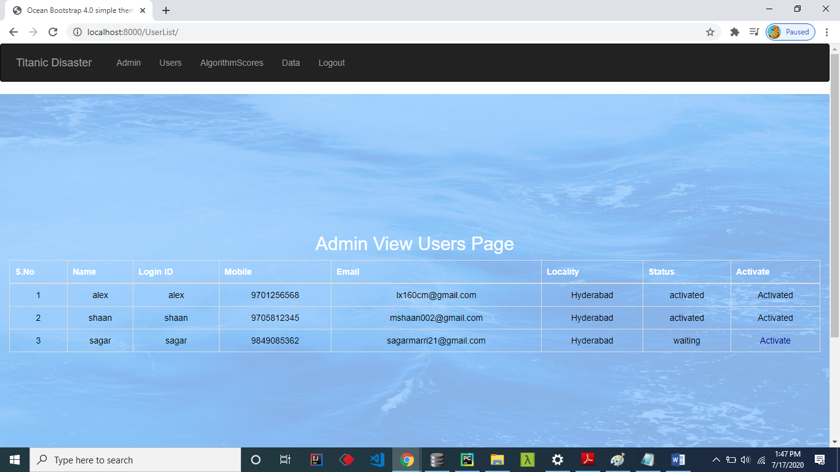
SCREENSHOTS
HOME PAGE:
ADMIN LOGIN PAGE:
User Register Form:
REGISTER USER:

Slide 9
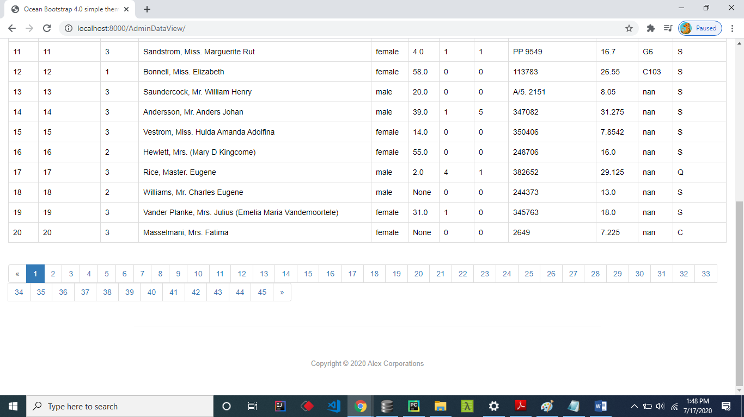
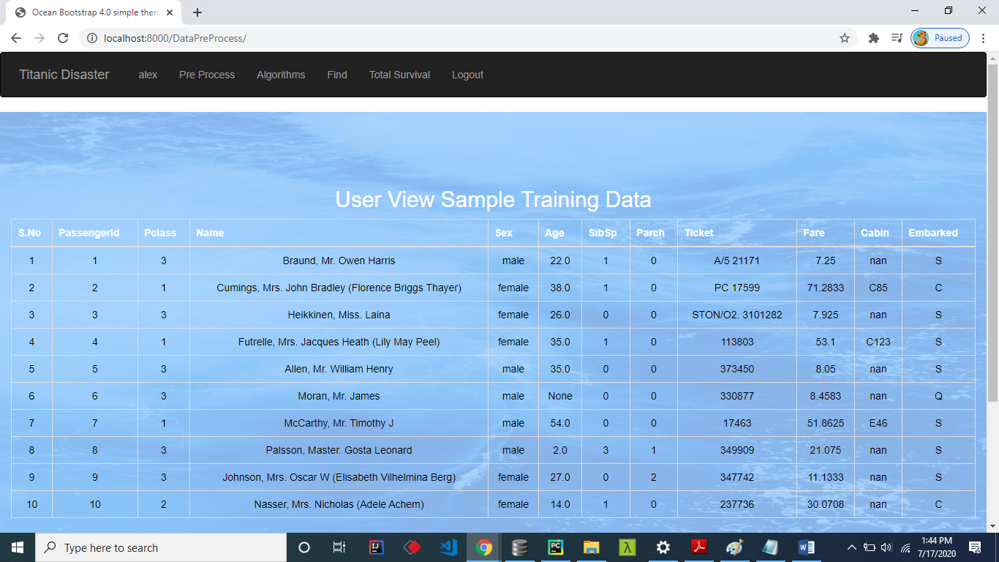

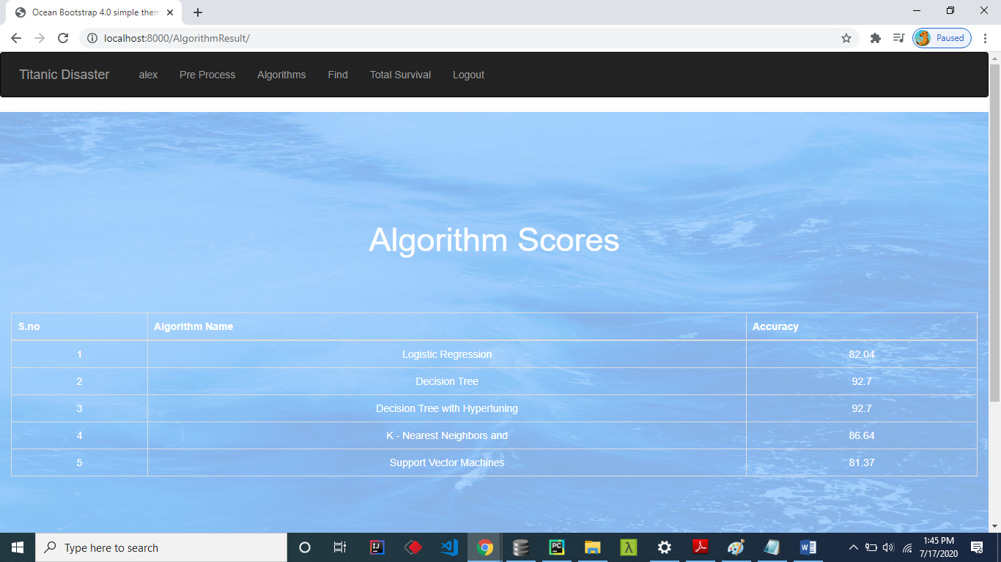
USER LOGIN FORM:
ALL TRAINED DATA:
CLEANED DATA:
USER LOGIN FORM:
ALGORITHMS:

Slide 10
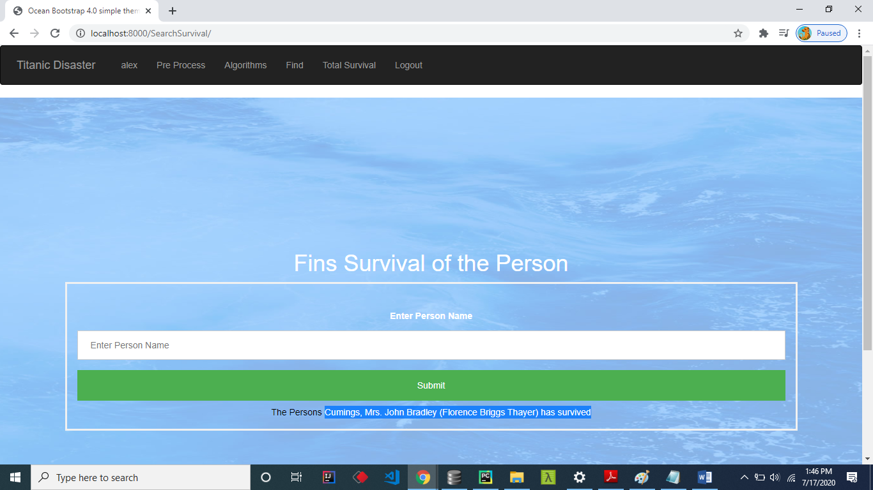
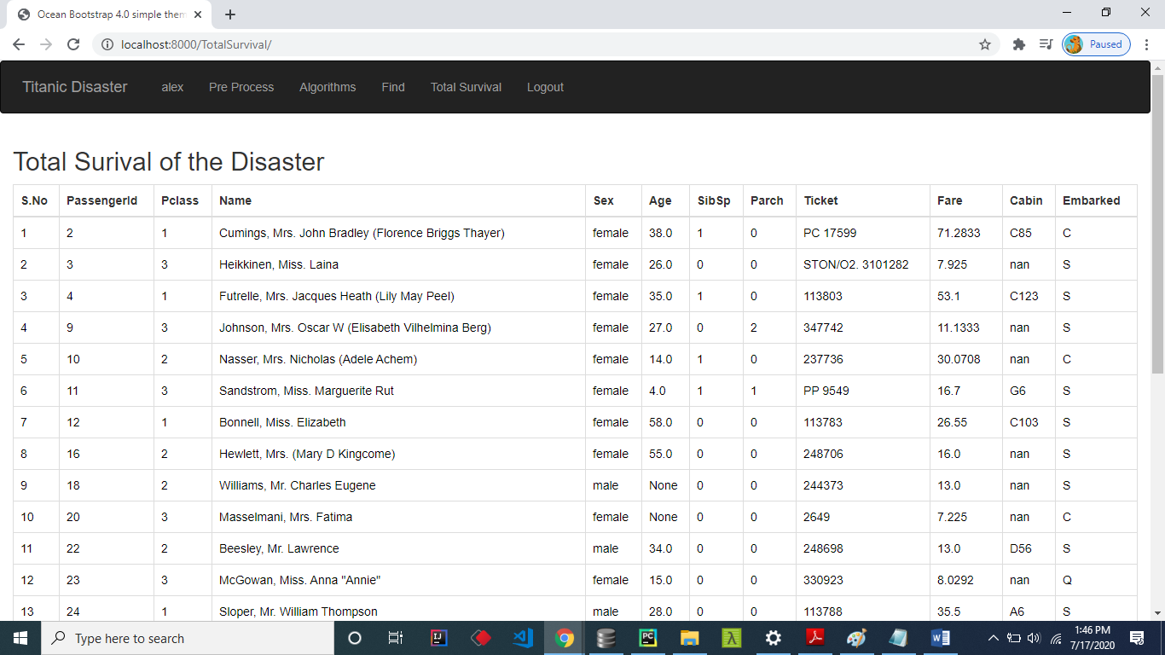
TOTAL SURVIVAL :
FINDING :

Slide 11
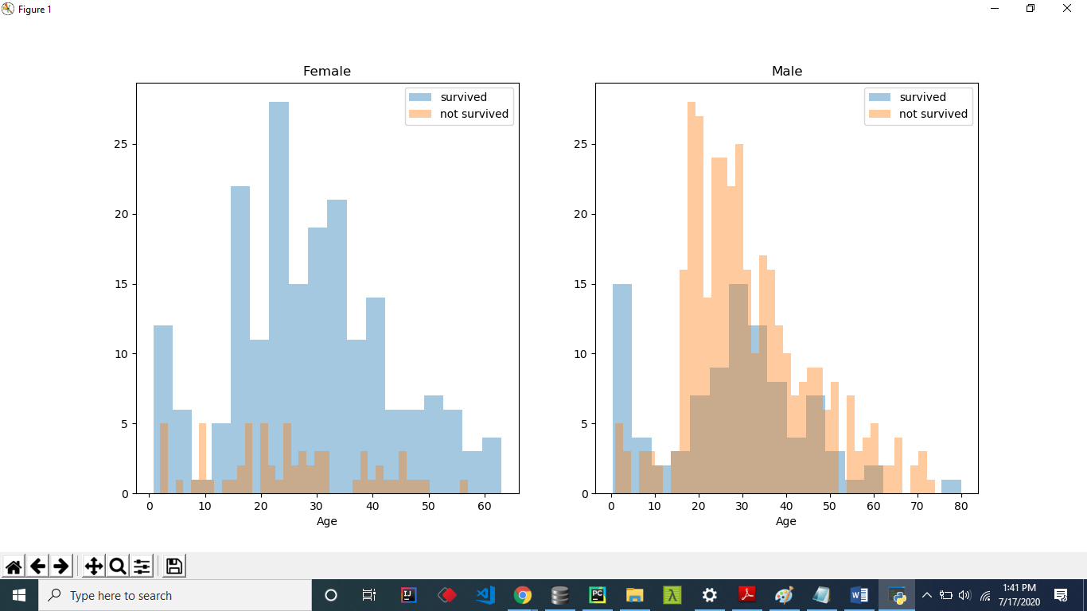
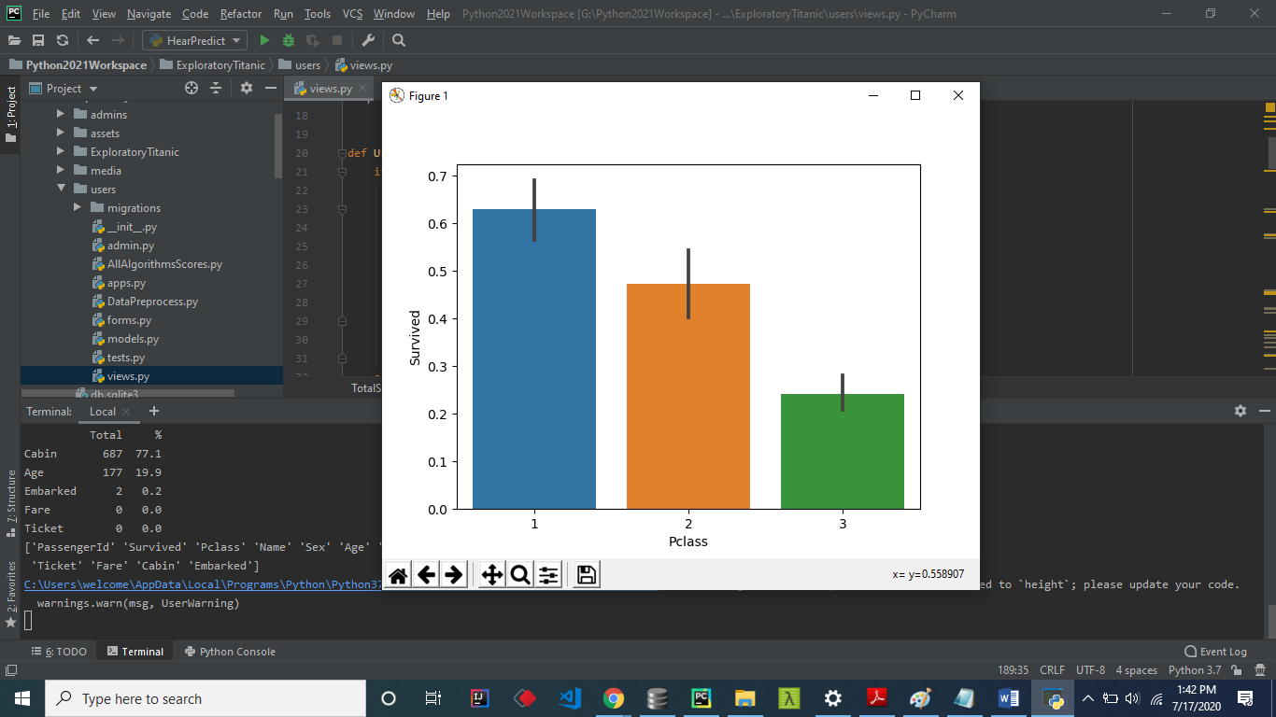
GRAPHS
Gender Survival Graph
Pclass VS Survival

Slide 12
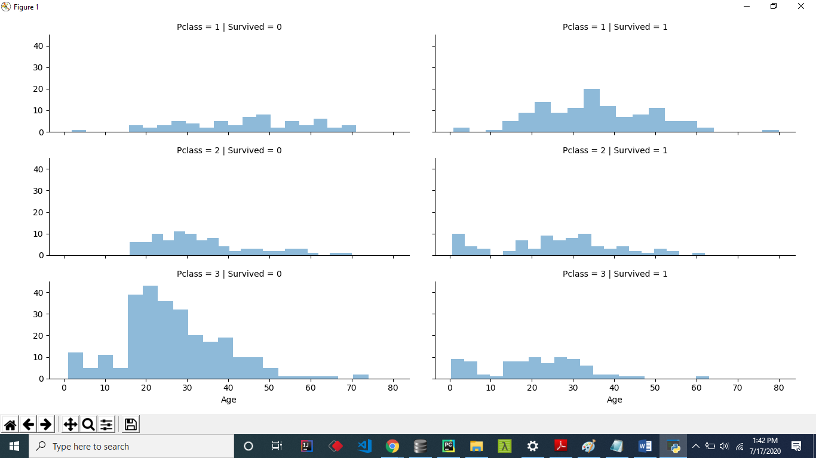
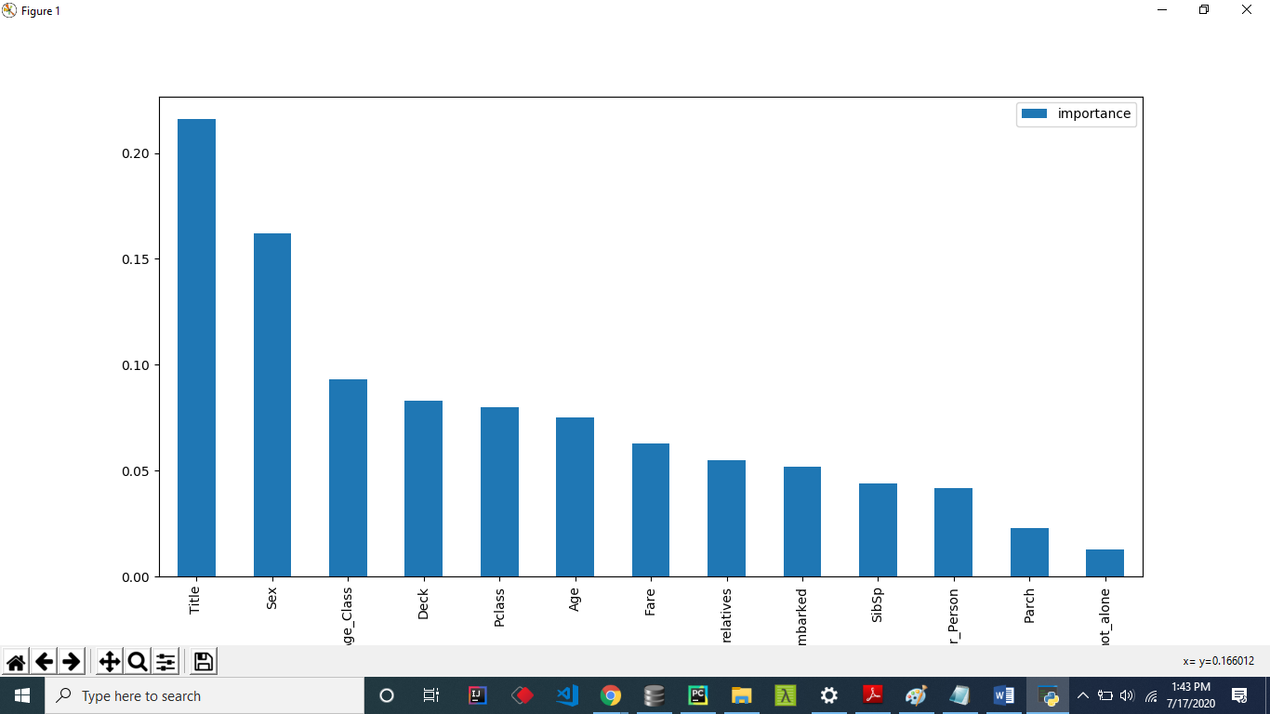
Survival Hist
Importance Rate

Slide 13
SYSTEM REQUIREMENTS
SOFTWARE REQUIREMENTS
Programming language : python
Applications : Django
Operating system : Windows 11 64bit OS
Debugger and Emulator : Any browser(chrome)
HARDWARE REQUIRMENTS
Processor : Intel i5
RAM : 8 GB
Space on Hard Disk : minimum 512GB

Slide 14
ALGORITHMS
LOGISTIC REGRESSION
Logistic regression is a way to predict whether something falls into one of two categories like yes/no(between 0 and 1)
If the probability is greater than 0.5, the model predicts "yes" Otherwise “No”
DECISION TREE
A decision tree is like a flowchart that helps you make decisions or predictions step by step.
At the top of the tree (root), you ask a question, Based on the answer
(like yes or no), you move to the next question or make a decision.

Slide 15
DECISION TREE WITH HYPERTUNING
A decision tree with a hyperparameter tuning means improving a decision tree by adjusting its settings (hyperparameters) to make it perform better
K-NEAREST NEIGHBORS
K-Nearest Neighbors (KNN) is a simple machine learning algorithm used for classification or regression tasks.
KNN classifies a new point by finding the "K" closest points in the data and
using their labels to make a decision.

Slide 16
SUPPORT VECTOR MACHINES
Support Vector Machines (SVM) is a powerful machine learning algorithm used for classification and sometimes regression.
It’s particularly useful for separating data into different categories when the data is not linearly separable.
SVM is a classifier that draws a line/hyperplane to separate data into categories.

Slide 17
USE CASE DIAGRAM

Slide 18
CONCLUSION
The comprehensive research gives us a result with decision tree having the highest score with 92.7% correct predictions and lowest false discovery rate.
The research also made us aware of the features that are so highly relevant to the prediction of survival of a passenger, with Sex being a feature with highest importance.

Slide 19


